Slide 1
Analyze This: Translating Business Needs into Technical Solutions
Presenters: Kailey Oppenheim and Tabitha Chew
TIM 101
April 14, 2016

Slide 2
Introductions
Tabitha Chew
tabitha.chew@accenture.com
Graduated from UCSC in 2014 with a BS in Technology Information Management
Internship with UCSC in 2013 gaining ServiceNow platform experience
Internship with Plantronics in 2013 as a Service Desk Intern
After graduation, obtained a full time position at Cloud Sherpas in 2014, now Accenture
Certifications:
ServiceNow Administrator
ServiceNow Implementation Specialist

Slide 3
Introductions
Kailey Oppenheim
kailey.oppenheim@accenture.com
Graduated from UCSC in 2009 with a BS in Information Systems Management (now TIM)
Internship with Plantronics as a business analyst in 2010, which transitioned to Full Time
In 2012, started working Full Time as a ServiceNow Business Analyst Consultant at Navigis (acquired by Cloud Sherpas, now acquired by Accenture)
From 2013 - 2014 worked for Macys.com
After graduation, obtained a full time position at Cloud Sherpas in 2014, now Accenture
Certifications:
ITIL Foundation in IT Service Management (ITIL Foundations v3)
Project Management Professional (PMP)
ServiceNow Administrator
ServiceNow Implementation Specialist
ServiceNow Trainer

Slide 4
Agenda
What is ServiceNow?
About Accenture
A day in the life of a Business Analyst
Questions

Slide 5
What is ServiceNow?

Slide 6
ServiceNow is…
Enterprise Cloud Company
Headquartered in Santa Clara, CA
Designed to automate enterprise IT operations
Replaces email, file sharing, running around, texting, phone calls, etc.
Enables executives and other associates to access information and reports that require attention at virtually any time

Slide 7
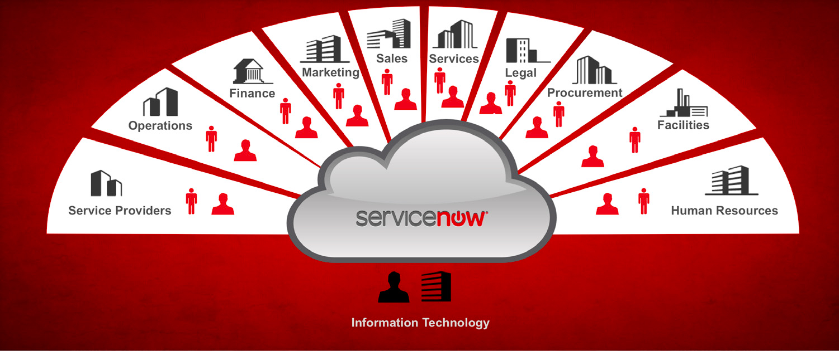
ServiceNow is…

Slide 8
Benefits of moving to ServiceNow
Transparency
Who is working on what?
What’s the status?
When will it be done?

Slide 9
Benefits of moving to ServiceNow
Contextual Security
Only users with the right access can create/ read/ write/ delete information
Different roles are leveraged (Administrator to End User)
Dynamic Security

Slide 10
Benefits of moving to ServiceNow
Integrations and Single Source of Truth
ServiceNow API allows data to move between IT systems
Example: Integration with Active Directory
User data (email, phone, address, name)
Authentication into the platform
Example: Integration with SalesForce.com
Single source of truth to manage data

Slide 11
Basic ServiceNow Architecture Overview
Cloud Benefits for the Business
Portability
Control
Real time updates
Web Browser (Client)
Request
Response
Internet
Data Center
Application Server
Database
Notes:
Kailey – explain diagram
Tabitha – Importance of the cloud
Cloud Benefits for the Business
Transparency
Full data access
Maintain responsibility and confidence
Portability
Retrieve data anywhere, anytime
Easily accessible
Long-term flexibility
Control
Ability to measure vendor service level performance
Access when you want it

Slide 12
ServiceNow Platform
Incident
Problem
Knowledge
Catalog
Configuration Management Database
Asset
HR
Facilities
Legal
Marketing
Etc.
Change

Slide 13
ServiceNow Demo

Slide 14
About Accenture – Cloud First

Slide 15
Accenture is…
A global management consulting, technology services, and outsourcing company
Serving clients in more than 120 countries
Leader in helping organizations move to the cloud
Worked on more than 13,000 cloud computing projects for clients
Includes three-quarters of the Fortune Global 100

Slide 16
Accenture ServiceNow Clients
Industries include:
Aerospace
Banking
Education
Energy
Financial Services
Food
Healthcare
Media
Real Estate
Retail
Technology

Slide 17
Where do we fit in Accenture?
Accenture
Strategy
Cloud First
Operations
Consulting
Digital
Technology
Salesforce
ServiceNow
Workday
Google

Slide 18
A day in the life of a Business Analyst

Slide 19
What is a business analyst?
Liaison between “the business” and “IT”
Translate business needs into technical requirements
Document process flows

Slide 20
Requirement Example
Business need: All employees will be able to submit a ticket when they need to report an issue.
Technical Requirement: A form visible to end users where the user can enter the following information:
Preferred call back number
Issue description
Impact
The ticket will route to the Service Desk for troubleshooting

Slide 21
What is a consultant?
con·sult·ant kənˈsəltnt/
noun
A person who provides expert advice professionally.
Work with many companies (clients)
Advisor of recommended processes
Subject matter expert (SME)

Slide 22
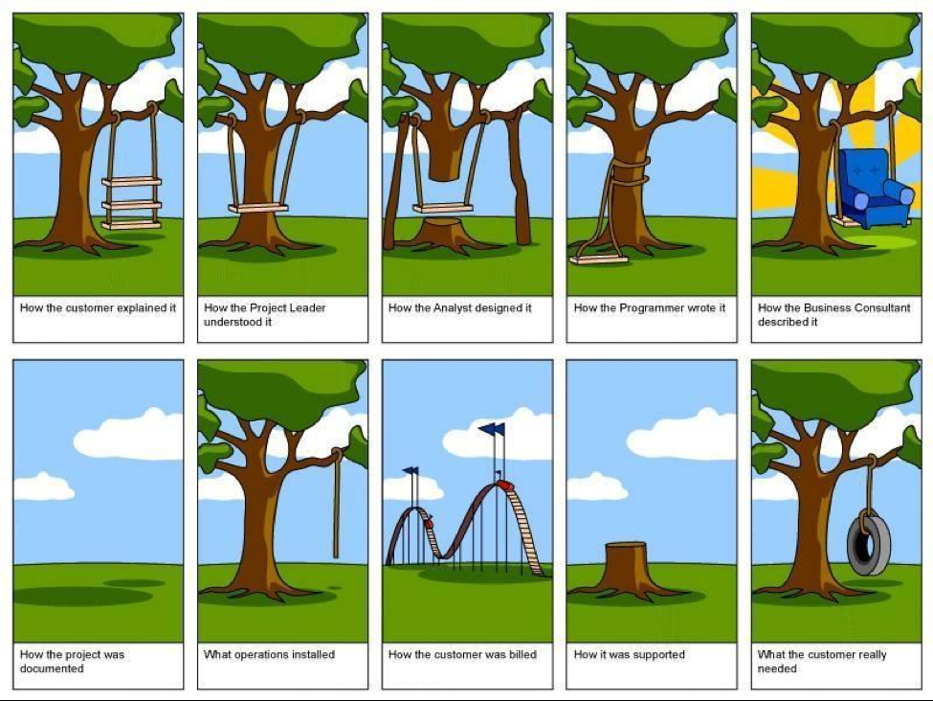

Slide 23
A Typical ServiceNow Requirements Workshop
Meet with project stakeholders at a client site
Process owners
Process managers
Process workers
Travel 50%
Remote follow up sessions (work from home)

Slide 24
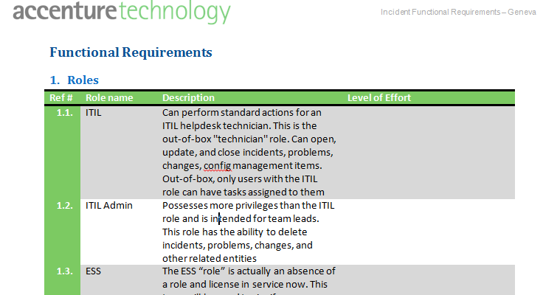
Requirements Document Example

Slide 25
Sample Process and Workflow Design
Service Catalog

Slide 26
Sample Process and Workflow Design
Change Management

Slide 27
Typical Project Lifecycle
Sales
Engagement Manager
Business Analyst
Implementation Specialist

Slide 28
Questions?
tabitha.chew@accenture.com
kailey.oppenheim@accenture.com

Slide 29
Thank you!

